Slide 1


Affordable Web Application Camera System to monitor footfall count in shops/stores.
Today the number of footfalls into a showroom is captured by the Sales Executives manually in a register or quotation book. How much of the footfalls are captured is at the discretion of the sales executive. In addition, no information about the prospect is captured like his demographic profile etc. hence it becomes difficult to make any meaningful analysis of leakages. Even if an app is provided to the sales executive to capture all footfalls, it is at his discretion whether to use it or not . Other technologies like infra-red based sensors are not efficient and such systems becomes useless in the event of group entries, multiple entries, employees' movements etc.
Team Name :
MIT Pune_Creators for Society
Team Members :
Adarsh Shinde
Sarthak Gagdani
Anurag Wani

Slide 2

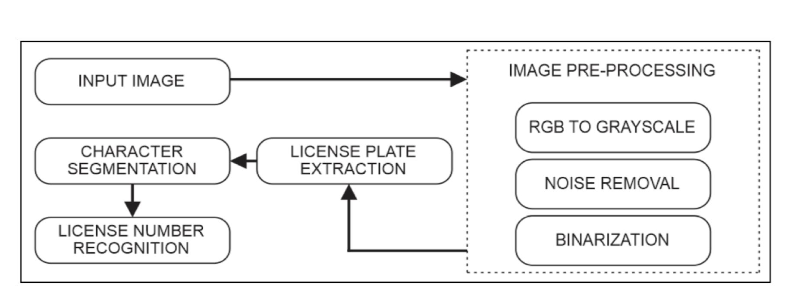
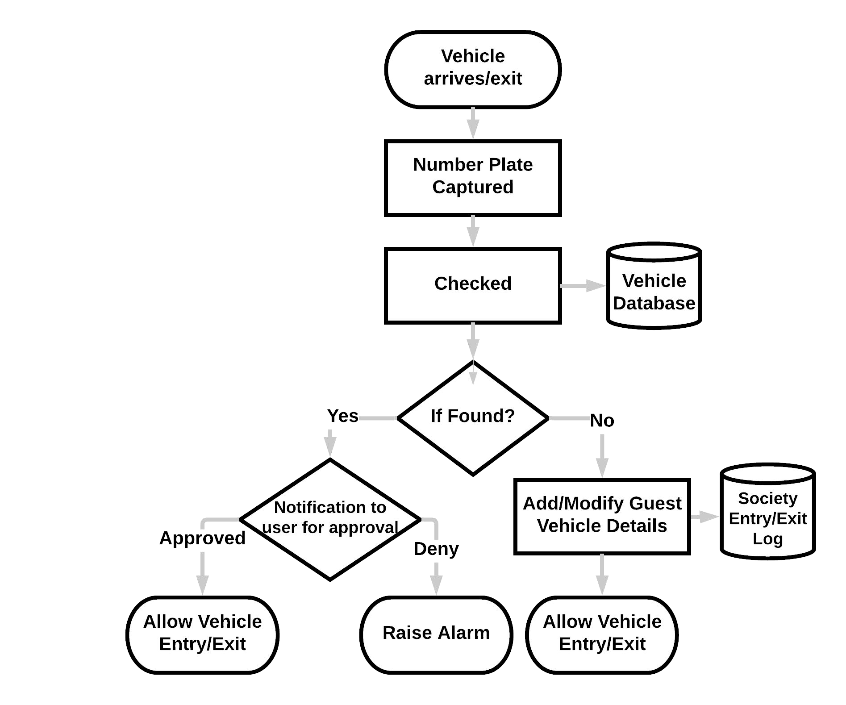
A web application which monitors footfall count for a shop/store. There will be an Admin Login (Secretary) . Admin can add/delete employees accordingly, so employees are not counted in footfall count.
Whenever a person enters, an FR (Face Recognition) CCTV camera captures the video of the person which is converted into frames followed by conversion to images.
Information Extracted
Face of Person
Sex of Person
Footfall Count
Person Enters the Store
FACE RECOGNITION
FACE DETECTION
Face Detected
FOOTFALL COUNTED
Checked
Employee
Database
Our System will identify the face of the person and check that in the employee face database if the person is detected as an employee the footfall will not be counted if the face is not found in database then the person is considered as customer and footfall is incremented.
Our web system provides analytics tools to analyze footfall count
Also reports can be generated accordingly.
Is a employee
Customer
Is a Customer
Footfall Counted

Slide 3








Features
Future Scope
Dependencies
Improve the security for shops and stores.
Provide Analytics for the Admin to manage/improve marketing campaigns.
Daily Report generation and Automation of tasks.
Multilingual support.
Can be implemented in shopping complexes, corporate offices, universities etc.
Footfall tells you how successful your marketing strategy is, in terms of drawing prospective customers’ attention.
Entry/Exit Log made available to law enforcement agencies for identifying suspicious activities.
Efforts and Cost
Cost :-
Efforts (in Hours) :-
Face Recognition using Neural Network

Slide 4
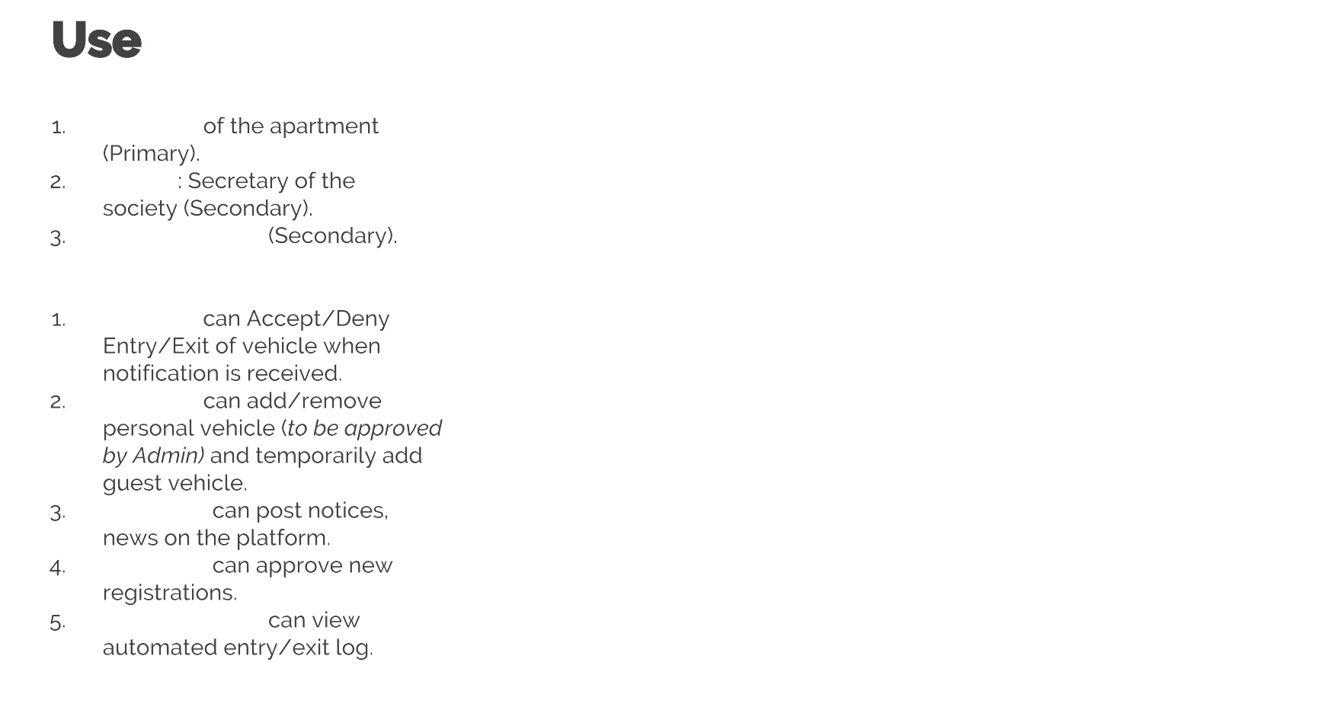
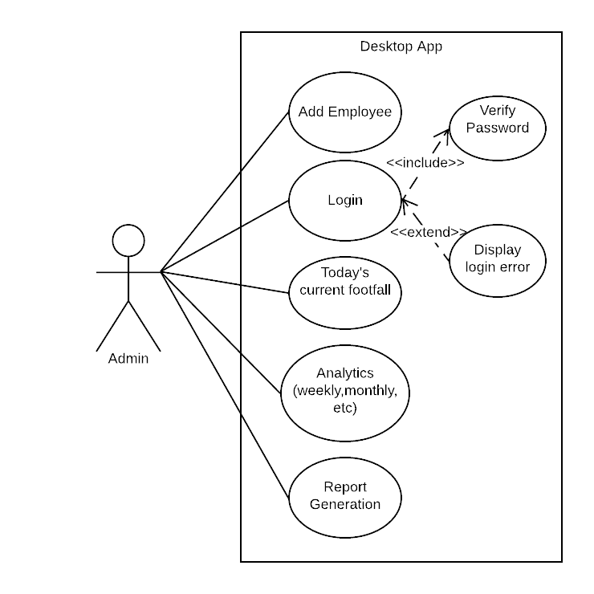
Important Use Cases
1. Admin can add and delete employee
2. Admin can view current footfall count for the day.
3. Admin can view analytics of footfall (weekly, monthly, yearly, etc).
4. Admin can generate reports accordingly.
Secretary
Secretary Security Guard

